Slide 1

2014 EU ETS Emissions analysis
(excludes aviation)
Key points:
Total emissions are 94mt down, or 4.9%.
Exact levels uncertain, as 10% of emissions have not been published (45% of which is Polish power stations)
Power and heat down 7.8% because of falling electricity consumption from milder weather, but also underlying falls.
Industry emissions fall 0.4%; does not include any heat installations, so is an underlying fall, despite EU industrial production rising 0.8%.
Fallers:
  UK due to coal/gas switching from carbon tax in summer
  Germany due to fall in hard coal due to renewables and less underlying electricity demand.
  France due to mild weather.
Risers:
  Spain due to more coal generation as gas CHP subsidies reduction reduced generation
  Netherlands emissions increased as new coal came on RWE’s Eemshaven and GDF Rotterdam plant

Slide 2
Emissions by Sector

Slide 3
Emissions by Country

Slide 4
Emissions changes 2013 to 2014

Slide 5
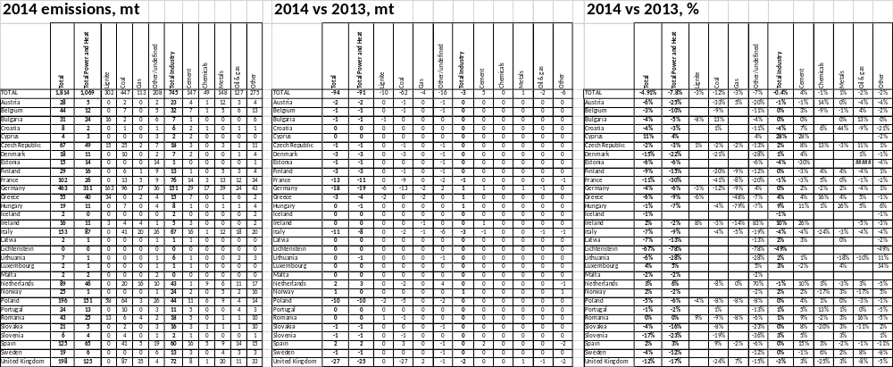
Detailed Emissions

Slide 6
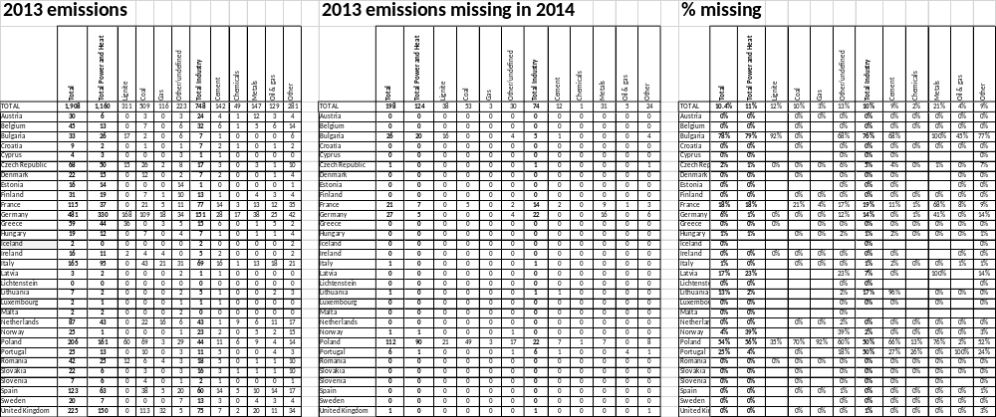
Incomplete data

Slide 7
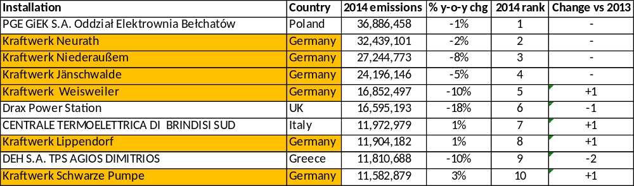
Top Emitters
10 year of the EU ETS: Who are the biggest emitters in 2014? The same as in 2005!
Will it be the same in 10 years’ time?!
Top 6 in 2005 | Top 6 in 2014
1 Bełchatów | 1 Bełchatów
2 Niederaußem | 2 Neurath
3 Jänschwalde | 3 Niederaußem
4 Drax | 4 Jänschwalde
5 Weisweiler | 5 Weisweiler
6 Neurath | 6 Drax

Slide 8
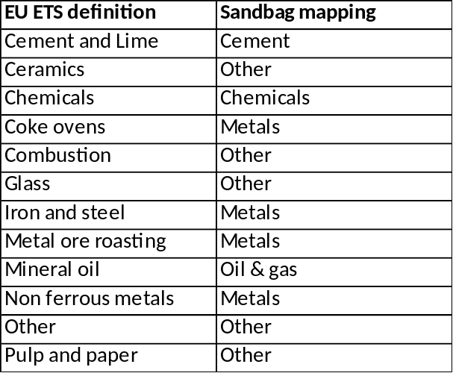
Definitions
Power and Heat sector
  Sandbag uses NACE codes, which we believe provide a better representation of what are power and heat installation, than does the “combustion” sector, which most analysts use. We also include additional installations which have no allocations.
  Specifically, Installations assigned to NACErev2 codes 35.00, 35.10, 35.11, 35.12, 35.13, 35.14 & 35.30 have been flagged as Power installations; additional CITL combustion sector installations have also been flagged as Power installations if have no free alloc PhaseIII but do have emissions 2013 (any NACErev2 code)
Industry
  Industry is everything that is not power.
  The category mapping as per the table, right:
Fuel type
  Sandbag has mapped Power and Heat
  installations by fuel, with 80% coverage.
Missing data
  Where data is missing for 2014 so far, so assume industry installations have the same emissions as 2013; however, since average power and heat emissions are down so much, we assume they are 8% lower than 2013.

